Slide 1

CSE 2006 - Programming in Java Course Type: LP Credits: 3

Slide 2
Unit-2 Java Object-oriented Programming
Java OOP (Basics)
Java Class and Objects, Java Methods, Java Constructor, Java Strings, Java Access Modifiers, Java this keyword, Java final keyword, Java Recursion, Java instance of Operator, Java Single Class and Anonymous Class, Java enum Class
Java OOP (Inheritance & Polymorphism)
Java Inheritance, Java Method Overriding, Java super Keyword, Abstract Class & Method, Java Interfaces, Java Polymorphism (overloading & overriding), Java Encapsulation
Java OOP (Other types of classes)
Nested & Inner Class, Java Static Class, Java Anonymous Class, Java Singleton, Java enum Class, Java enum Constructor, Java enum String, Java Reflection

Slide 3
Abstract class in Java
A class which is declared with the abstract keyword is known as an abstract class in Java.
It can have abstract and non-abstract methods (method with the body).
Abstraction in Java
Abstraction is a process of hiding the implementation details and showing only functionality to the user.
Another way, it shows only essential things to the user and hides the internal details
Example, sending SMS where you type the text and send the message.
You don't know the internal processing about the message delivery.
Abstraction lets you focus on what the object does instead of how it does it. Ways to achieve Abstraction
There are two ways to achieve abstraction in java
Abstract class and Interface.

Slide 4
Abstract class in Java
Abstract class in Java
A class which is declared as abstract is known as an abstract class.
It can have abstract and non-abstract methods. It needs to be extended and its method implemented. It cannot be instantiated.
Points to Remember
An abstract class must be declared with an abstract keyword.
It can have abstract and non-abstract methods.
It cannot be instantiated.
It can have constructors and static methods also.
It can have final methods which will force the subclass not to change the body of the method.
Example of abstract class
abstract class A{}

Slide 5
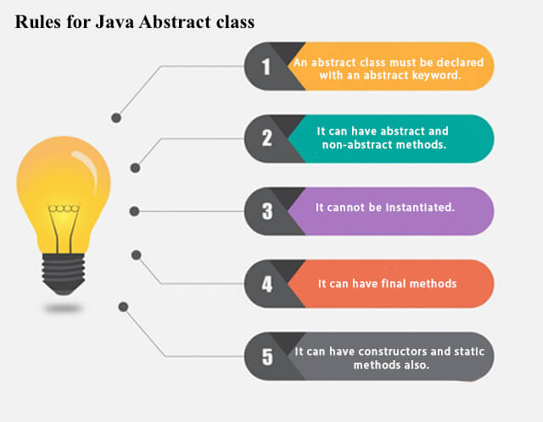
Abstract class in Java

Slide 6
Abstract class in Java
Abstract Method in Java
A method which is declared as abstract and does not have implementation is known as an abstract method.
Example of abstract method
abstract void printStatus(); //no method body and abstract

Slide 7
Abstract class in Java
Example of Abstract class that has an abstract method
In this example, Bike is an abstract class that contains only one abstract method run. Its implementation is provided by the Honda class.
abstract class Bike
{
abstract void run();
}
class Honda4 extends Bike{
void run()
{System.out.println("running safely");}
public static void main(String args[]){
Bike obj = new Honda4();
obj.run();
}
}
Output:
running safely

Slide 8
In this example, create the instance of Rectangle class, draw() method of Rectangle class will be invoked.
File: TestAbstraction1.java
abstract class Shape
{ abstract void draw(); }
//In real scenario, implementation is provided by others i.e. unknown by end user
class Rectangle extends Shape{
void draw(){System.out.println("drawing rectangle");}
}
class Circle1 extends Shape
{ void draw(){System.out.println("drawing circle");} }
//In real scenario, method is called by programmer or user
class TestAbstraction1{
public static void main(String args[]){
Shape s=new Circle1();
//In a real scenario, object is provided through method, e.g., getShape() method
s.draw();
}
}
Note: Object cannot created by abstract class.
Output:
drawing circle

Slide 9
Abstract class in Java
Another example of Abstract class in java
File: TestBank.java
abstract class Bank
{ abstract int getRateOfInterest(); }
class SBI extends Bank{
int getRateOfInterest(){return 7;}
}
class PNB extends Bank{
int getRateOfInterest(){return 8;}
}
class TestBank{
public static void main(String args[]){
Bank b;
b=new SBI();
System.out.println("Rate of Interest is: "+b.getRateOfInterest()+" %");
b=new PNB();
System.out.println("Rate of Interest is: "+b.getRateOfInterest()+" %");
}}
Output:
Rate of Interest is: 7 %
Rate of Interest is: 8 %

Slide 10
Abstract class in Java
Abstract class having constructor, data member and methods
An abstract class can have a data member, abstract method, method body (non-abstract method), constructor, and even main() method.
File: TestAbstraction2.java
//Example of an abstract class that has abstract and non-abstract methods
abstract class Bike{
Bike() {System.out.println("bike is created");}
abstract void run();
void changeGear() {System.out.println("gear changed");} }
//Creating a Child class which inherits Abstract class
class Honda extends Bike{
void run(){System.out.println("running safely..");} }
//Creating a Test class which calls abstract and non-abstract methods
class TestAbstraction2{
public static void main(String args[]){
Bike obj = new Honda();
obj.run();
obj.changeGear();
} }
Output:
bike is created
running safely..
gear changed

Slide 11
Abstract class in Java
Rule: If there is an abstract method in a class, that class must be abstract.
class Bike12
{
abstract void run();
}
Output:
compile time error
Rule: If you are extending an abstract class that has an abstract method, you must either provide the implementation of the method or make this class abstract.

Slide 12
// A Simple demonstration of abstract.
abstract class A {
abstract void callme();
// concrete methods are still allowed in abstract classes
void callmetoo() {
System.out.println("This is a concrete method.");
}
}
class B extends A {
void callme() {
System.out.println("B's implementation of callme.");
}
}
class AbstractDemo {
public static void main(String args[]) {
B b = new B();
b.callme();
b.callmetoo();
}
}
Output:
B's implementation of callme
This is a concrete method

Slide 13
Abstract class in Java
Abstract class in Java references:
https://youtu.be/p_4Dyfplqkw
Edureka: https://youtu.be/5X0Y--92pMI
Tutorial point: https://youtu.be/vkYJFrTrh5M

Slide 14
Interfaces in Java
Interface in Java
An interface in Java is a blueprint of a class. It has static constants and abstract methods.
The interface in Java is a mechanism to achieve abstraction. There can be only abstract methods in the Java interface, not method body. It is used to achieve abstraction and multiple inheritance in Java.
In other words, you can say that interfaces can have abstract methods and variables. It cannot have a method body.
Java Interface also represents the IS-A relationship.
It cannot be instantiated just like the abstract class.
Since Java 8, we can have default and static methods in an interface.
Since Java 9, we can have private methods in an interface.
Why use Java interface?
There are mainly three reasons to use interface. They are given below.
It is used to achieve abstraction.
By interface, we can support the functionality of multiple inheritance.
It can be used to achieve loose coupling.

Slide 15
Interfaces in Java
How to declare an interface?
An interface is declared by using the interface keyword.
It provides total abstraction; means all the methods in an interface are declared with the empty body, and all the fields are public, static and final by default.
A class that implements an interface must implement all the methods declared in the interface.
Syntax:
interface <interface_name>
{
// declare constant fields
// declare methods that abstract
// by default.
}
Interface in Java:
https://www.javatpoint.com/interface-in-java
https://youtu.be/jJ8L3SeFy_E

Slide 16
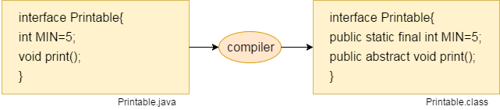
Interfaces in Java
Internal addition by the compiler
The Java compiler adds public and abstract keywords before the interface method. Moreover, it adds public, static and final keywords before data members.
In other words, Interface fields are public, static and final by default, and the methods are public and abstract.

Slide 17
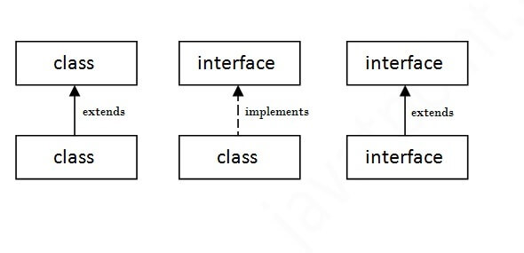
Interfaces in Java
The relationship between classes and interfaces
As shown in the figure given below, a class extends another class, an interface extends another interface, but a class implements an interface.

Slide 18
Interfaces in Java
Java Interface Example
In this example, the Printable interface has only one method, and its implementation is provided in the A6 class.
interface printable
{
void print();
}
class A6 implements printable{
public void print()
{System.out.println("Hello");}
public static void main(String args[]){
A6 obj = new A6();
obj.print();
}
}
Output:
Hello

Slide 19
Interfaces in Java
Java Interface Example: Drawable
In this example, the Drawable interface has only one method.
Its implementation is provided by Rectangle and Circle classes.
In a real scenario, an interface is defined by someone else, but its implementation is provided by different implementation providers.
Moreover, it is used by someone else. The implementation part is hidden by the user who uses the interface.

Slide 20
Interfaces in Java
Java Interface Example: Drawable
File: TestInterface1.java
//Interface declaration: by first user
interface Drawable{
void draw();
}
//Implementation: by second user
class Rectangle implements Drawable{
public void draw(){System.out.println("drawing rectangle");}
}
class Circle implements Drawable{
public void draw(){System.out.println("drawing circle");}
}
//Using interface: by third user
class TestInterface1
{
public static void main(String args[]){
Drawable d=new Circle(); //In real scenario, object is provided by method e.g. getDrawable()
d.draw();
}}
Output:
drawing circle

Slide 21
Interfaces in Java
Java Interface Example: Bank
Let's see another example of java interface which provides the implementation of Bank interface.
File: TestInterface2.java
interface Bank{
float rateOfInterest();
}
class SBI implements Bank{
public float rateOfInterest(){return 9.15f;}
}
class PNB implements Bank{
public float rateOfInterest(){return 9.7f;}
}
class TestInterface2{
public static void main(String[] args){
Bank b=new SBI();
System.out.println("ROI: "+b.rateOfInterest());
}}
Output:
ROI: 9.15

Slide 22
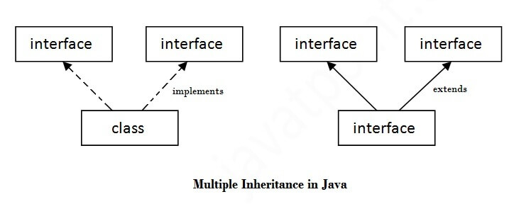
Interfaces in Java
Multiple inheritance in Java by interface
If a class implements multiple interfaces, or an interface extends multiple interfaces, it is known as multiple inheritance.

Slide 23
Interfaces in Java
interface Printable
{
void print();
}
interface Showable{
void show();
}
class A7 implements Printable,Showable{
public void print(){System.out.println("Hello");}
public void show(){System.out.println("Welcome");}
public static void main(String args[]){
A7 obj = new A7();
obj.print();
obj.show();
}
}
Output:
Hello
Welcome

Slide 24
Interfaces in Java
Q) Multiple inheritance is not supported through class in java, but it is possible by an interface, why?
As we have explained in the inheritance chapter, multiple inheritance is not supported in the case of class because of ambiguity. However, it is supported in case of an interface because there is no ambiguity. It is because its implementation is provided by the implementation class. For example:
interface Printable{
void print();
}
interface Showable{
void print();
}
class TestInterface3 implements Printable, Showable
{
public void print(){System.out.println("Hello");}
public static void main(String args[]){
TestInterface3 obj = new TestInterface3();
obj.print();
}
}
Output:
Hello
As you can see in the above example, Printable and Showable interface have same methods but its implementation is provided by class TestTnterface1, so there is no ambiguity.

Slide 25
Interfaces in Java
Interface inheritance
A class implements an interface, but one interface extends another interface.
interface Printable{
void print();
}
interface Showable extends Printable{
void show();
}
class TestInterface4 implements Showable{
public void print(){System.out.println("Hello");}
public void show(){System.out.println("Welcome");}
public static void main(String args[]){
TestInterface4 obj = new TestInterface4();
obj.print();
obj.show();
}
}
Output:
Hello
Welcome

Slide 26
Interfaces in Java
Java 8 Static Method in Interface
Since Java 8, we can have static method in interface. Let's see an example:
File: TestInterfaceStatic.java
interface Drawable{
void draw();
static int cube(int x){return x*x*x;}
}
class Rectangle implements Drawable{
public void draw(){System.out.println("drawing rectangle");}
}
class TestInterfaceStatic{
public static void main(String args[]){
Drawable d=new Rectangle();
d.draw();
System.out.println(Drawable.cube(3));
}}
Output:
drawing rectangle 27

Slide 27
Interfaces in Java
Q) What is marker or tagged interface?
An interface which has no member is known as a marker or tagged interface, for example, Serializable, Cloneable, Remote, etc. They are used to provide some essential information to the JVM so that JVM may perform some useful operation.
//How Serializable interface is written?
public interface Serializable
{ }
Nested Interface in Java
Note: An interface can have another interface which is known as a nested interface. We will learn it in detail in the nested classes chapter.
For example:
interface printable{
void print();
interface MessagePrintable{
void msg();
}
}

Slide 28
Interfaces in Java
Can we define a class inside the interface?
Yes, if we define a class inside the interface, the Java compiler creates a static nested class.
Let's see how can we define a class within the interface:
interface M
{
class A{}
}

Slide 29
Interfaces in Java
Example of nested interface which is declared within the interface
In this example, we will learn how to declare the nested interface and how we can access it.
TestNestedInterface1.java
interface Showable{
void show();
interface Message{
void msg();
}
}
class TestNestedInterface1 implements Showable.Message{
public void msg(){System.out.println("Hello nested interface");}
public static void main(String args[]){
Showable.Message message=new TestNestedInterface1();//upcasting here
message.msg();
}
}
Output:
hello nested interface

Slide 30
Interfaces in Java
Example of nested interface which is declared within the class
Let's see how we can define an interface inside the class and how we can access it.
TestNestedInterface2.java
class A{
interface Message{
void msg();
}
}
class TestNestedInterface2 implements A.Message{
public void msg(){System.out.println("Hello nested interface");}
public static void main(String args[]){
A.Message message=new TestNestedInterface2();//upcasting here
message.msg();
}
}
Output:
hello nested interface

Slide 31
Difference between abstract class and interface
Abstract class | Interface
1) Abstract class can have abstract and non-abstract methods. | Interface can have only abstract methods. Since Java 8, it can have default and static methods also.
2) Abstract class doesn't support multiple inheritance. | Interface supports multiple inheritance.
3) Abstract class can have final, non-final, static and non-static variables. | Interface has only static and final variables.
4) Abstract class can provide the implementation of interface. | Interface can't provide the implementation of abstract class.
5) The abstract keyword is used to declare abstract class. | The interface keyword is used to declare interface.
6) An abstract class can extend another Java class and implement multiple Java interfaces. | An interface can extend another Java interface only.
7) An abstract class can be extended using keyword "extends". | An interface can be implemented using keyword "implements".
8) A Java abstract class can have class members like private, protected, etc. | Members of a Java interface are public by default.
9)Example: public abstract class Shape{ public abstract void draw(); } | Example: public interface Drawable{ void draw(); }

Slide 32
Example of abstract class and interface in Java
/Creating interface that has 4 methods
interface A{
void a();//bydefault, public and abstract
void b();
void c();
void d();
}
//Creating abstract class that provides the implementation of one method of A interface
abstract class B implements A{
public void c()
{System.out.println("I am C");}
}
//Creating subclass of abstract class, now we need to provide the implementation of rest of the methods
class M extends B{
public void a(){System.out.println("I am a");}
public void b(){System.out.println("I am b");}
public void d(){System.out.println("I am d");}
}
//Creating a test class that calls the methods of A interface
class Test5{
public static void main(String args[])
{
A a=new M();
a.a();
a.b();
a.c();
a.d();
}}
Output:
I am a
I am b
I am c
I am d

Slide 33
Applying Interfaces
interface IntStack // Define an integer stack interface
{
void push(int item); // store an item
int pop(); // retrieve an item
}
// An implementation of IntStack that uses fixed storage.
class FixedStack implements IntStack {
private int stck[];
private int tos;
// allocate and initialize stack
FixedStack(int size) {
stck = new int[size];
tos = -1; }

Slide 34
// Push an item onto the stack
public void push(int item) {
if(tos==stck.length-1) // use length member
System.out.println("Stack is full.");
else
stck[++tos] = item;
}
// Pop an item from the stack
public int pop() {
if(tos < 0) {
System.out.println("Stack underflow.");
return 0; }
else
return stck[tos--]; } }

Slide 35
class IFTest {
public static void main(String args[]) {
FixedStack mystack1 = new FixedStack(5);
FixedStack mystack2 = new FixedStack(8);
// push some numbers onto the stack
for(int i=0; i<5; i++) mystack1.push(i);
for(int i=0; i<8; i++) mystack2.push(i);
// pop those numbers off the stack
System.out.println("Stack in mystack1:");
for(int i=0; i<5; i++)
System.out.println(mystack1.pop());
System.out.println("Stack in mystack2:");
for(int i=0; i<8; i++)
System.out.println(mystack2.pop());
} }

Slide 36
Interfaces can be Extended
One interface can inherit another by use of the keyword extends.
When a class implements an interface that inherits another interface, it must provide implementations for all methods defined within the interface inheritance chain.

Slide 37
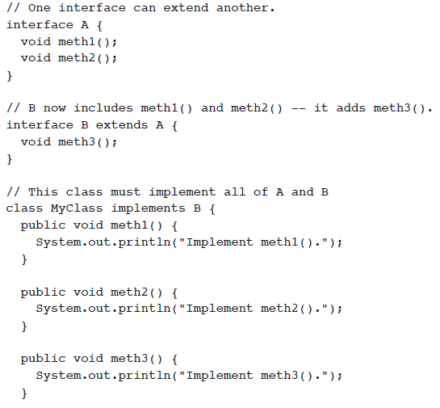

Slide 38

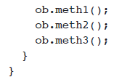

Slide 39
Unit-2 Java Object-oriented Programming
Java OOP (Basics)
Java Class and Objects, Java Methods, Java Constructor, Java Strings, Java Access Modifiers, Java this keyword, Java final keyword, Java Recursion, Java instance of Operator, Java Single Class and Anonymous Class, Java enum Class
Java OOP (Inheritance & Polymorphism)
Java Inheritance, Java Method Overriding, Java super Keyword, Abstract Class & Method, Java Interfaces, Java Polymorphism (overloading & overriding), Java Encapsulation
Java OOP (Other types of classes)
Nested & Inner Class, Java Static Class, Java Anonymous Class, Java Singleton, Java enum Class, Java enum Constructor, Java enum String, Java Reflection

Slide 40
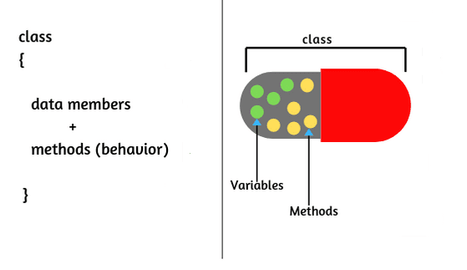
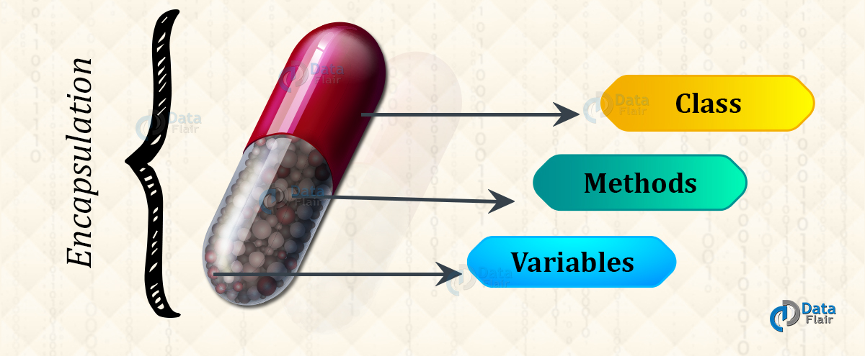
Encapsulation in Java

Slide 41
Encapsulation
Encapsulation is one of the four fundamental OOP concepts. The other three are inheritance, polymorphism, and abstraction.
Encapsulation in Java is a mechanism of wrapping the data (variables) and code acting on the data (methods) together as a single unit.
In encapsulation, the variables of a class will be hidden from other classes, and can be accessed only through the methods of their current class. Therefore, it is also known as data hiding.
To achieve encapsulation in Java −
Declare the variables of a class as private.
Provide public setter and getter methods to modify and view the variables values.
Benefits of Encapsulation
The fields of a class can be made read-only or write-only.
A class can have total control over what is stored in its fields.

Slide 42
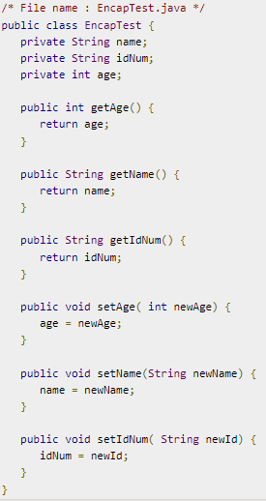
Encapsulation

Slide 43
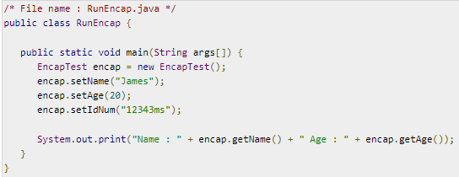
Encapsulation
Output
Name : James Age : 20

Slide 44
Encapsulation
class EncapsulationDemo
{
private int ssn;
private String empName;
private int empAge; //Getter and Setter methods
public int getEmpSSN()
{ return ssn; }
public String getEmpName()
{ return empName; }
public int getEmpAge()
{ return empAge; }
public void setEmpAge(int newValue)
{ empAge = newValue; }
public void setEmpName(String newValue)
{ empName = newValue; }
public void setEmpSSN(int newValue)
{ ssn = newValue; }
}

Slide 45
Encapsulation
Output:
Employee Name: Mario
Employee SSN: 112233
Employee Age: 32
public class EncapsTest
{
public static void main(String args[])
{
EncapsulationDemo obj = new EncapsulationDemo(); obj.setEmpName("Mario");
obj.setEmpAge(32);
obj.setEmpSSN(112233);
System.out.println("Employee Name: " + obj.getEmpName()); System.out.println("Employee SSN: " + obj.getEmpSSN()); System.out.println("Employee Age: " + obj.getEmpAge());
}
}
In above example all the three data members (or data fields) are private(see: Access Modifiers in Java) which cannot be accessed directly. These fields can be accessed via public methods only. Fields empName, ssn and empAge are made hidden data fields using encapsulation technique of OOPs.

